Slide 2
Chapter 1: Introduction
Part A: Core Concepts
Part B: The Practicalities
Rationale, Scope and Background of Cultural Risk Assessment and CIERA
Chapter 2:
Chapter 8:
Cultural Risk Assessment & The Cultural Inclusivity and Equity Risk Assessment (CIERA)
Chapter 3: Cultural Risk – EEDI and Bias
Activating Theory -
England and Wales Cricket Board
Chapter 9:
Chapter 4: The Science of Inclusion and Bias
Managing Organisational Risk: Integrating Cultural Risk Awareness into Corporate Governance
Chapter 10:
Chapter 5: Culture
Chapter 11:
Comparing faith in cultural contexts: In Sacred Spaces and on the Dancefloor
Chapter 6: Theories and Frameworks
Chapter 12:
Activating Theory - Action Research with Faith Leaders for the British Ritual Innovation in COVID
Chapter 7: Cultural Intelligence (CQ)
Chapter 13:
Between the lines -
Conversations in Context, a Dialogical Approach
Part C: Case Studies
CS 1: Sweden – Religious Heritage
CS 10: UK – Faith and Sexuality
CS 2: UK – Sensory Rooms
CS 6: Qatar – Football World Cup
CS 11: UK – Cultural Events
CS 3: England – Prom Events
CS 7: USA – NFL
CS 12: USA – Belonging and Ethnicity
CS 4: UAE – Cultural Awareness
CS 8: Japan – Cultural Heritage
CS 13: Caribbean – Diaspora Communities
CS 5: Australia – Indigenous Communities
CS 9: UK – Sport and Gender
CS 14: Nigeria – Business Events

Slide 3
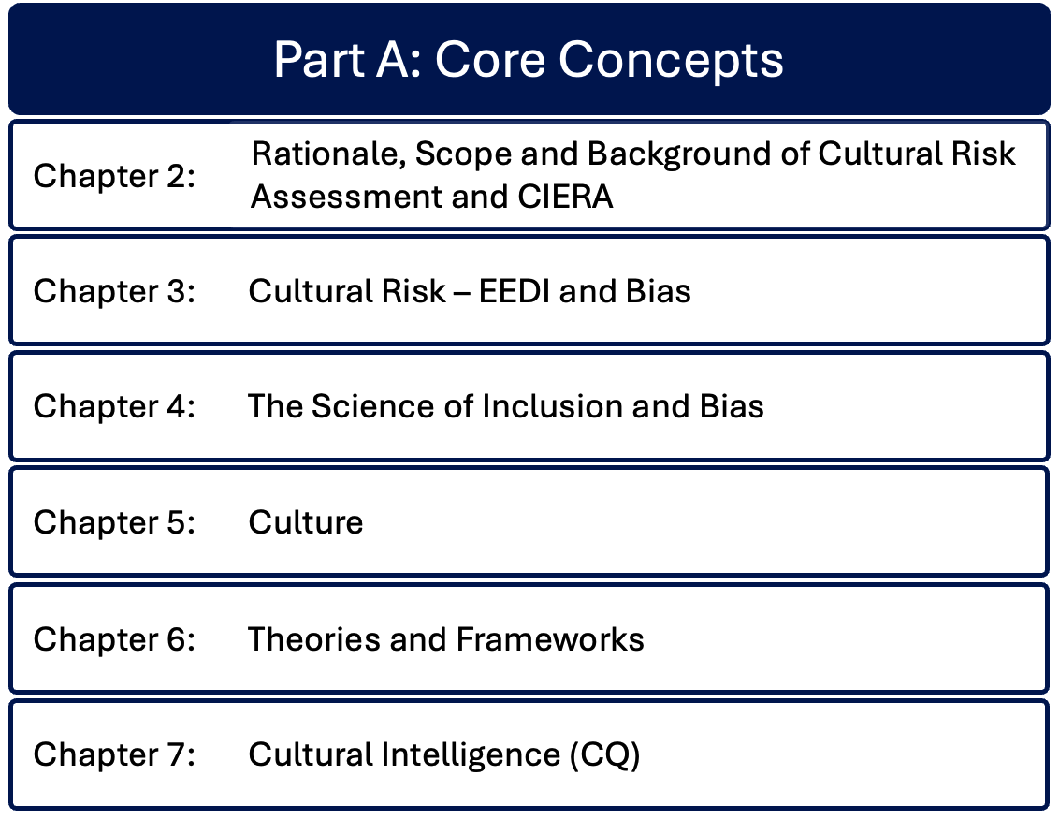

Slide 4
Chapter 3: Cultural risk - EEDI and bias
Bernadette Albert
Considers EEDI in contemporary cultural and professional settings, with a contextual explanation of EEDI from historical perspectives
Discusses: intersectionality and super-diversity, exploring their relevance to the events industry to create more inclusive spaces and events; theoretical backgrounds to diversity, equity, equality, and inclusion, connecting them to cultural risk on a practical level; cultural risk as a lens for creating inclusion and representation; power dynamics and unconscious bias from its cognitive foundations; the impact of System 1 and System 2 brain on unconscious bias and stereotyping.

Slide 5
Importance of EEDI in contemporary culture and professional settings
EEDI concepts intersect to facilitate diverse society
Complexities – systemic, structural and institutional barriers to diversity, conscious and unconscious bias
EDI strategies in place since the 1980s
Superdiversity and multiculturalism bring benefits of having a diverse workforce
Move from visual focus – diverse-looking employees or performative diversity, to tapping into skills and attributes brought to and embedded in the business environment
Role of EEDI in Cultural Intellingence and mitigation of cultural risks

Slide 6
Contextualization – historical perspectives of EEDI
Ancient Greek origins of cultural superiority – others seen as ‘less than Greeks’
Ideas of superior and inferior race and ethnicity introduced from mid-1400s
Trans-Atlantic slave trade set challenges that continue today
Global development of EDI rooted in Abolitionist movement 18th and 19th centuries
But US and Caribbean practices continued with indentured servitude
Exploitation continued in the USA into the 1960s
Changes introduced in law, yet discrimination persisted

Slide 7
Thematic pillars of intersectionality – multiple marginal identities
Relationality: Focuses on the importance of relationships and the contexts in gaining an understanding of social identities and inequalities.
Social inequality: Explores how social stratification in its various forms (e.g. race, gender, and class) overlap and contribute to systemic inequalities.
Complexity: Argues for resistance to oversimplify the multifaceted nature of social phenomenon when forming an analysis of social dynamics.
Social context: Ensures that consideration is given to historical and cultural settings where inequalities and marginalisation impact those intersecting identities.
Power relations: Considers where power operates through interconnected structures that define opportunities and experiences
Social justice: Applies intersectional insights to support transformative practice which seeks to deliver equity and justice.

Slide 8
Intersectionality
Discrimination compounded by those with multiple marginalised identities
Superdiversity – multiple dimensions of identity
Race, ethnicity, gender, sexuality
Immigration status, country of origin, language, economic background, religion
Significance of understanding intersectionality in creating welcoming events and event spaces for diverse attendees
See Dimensions of Diversity Figure

Slide 9
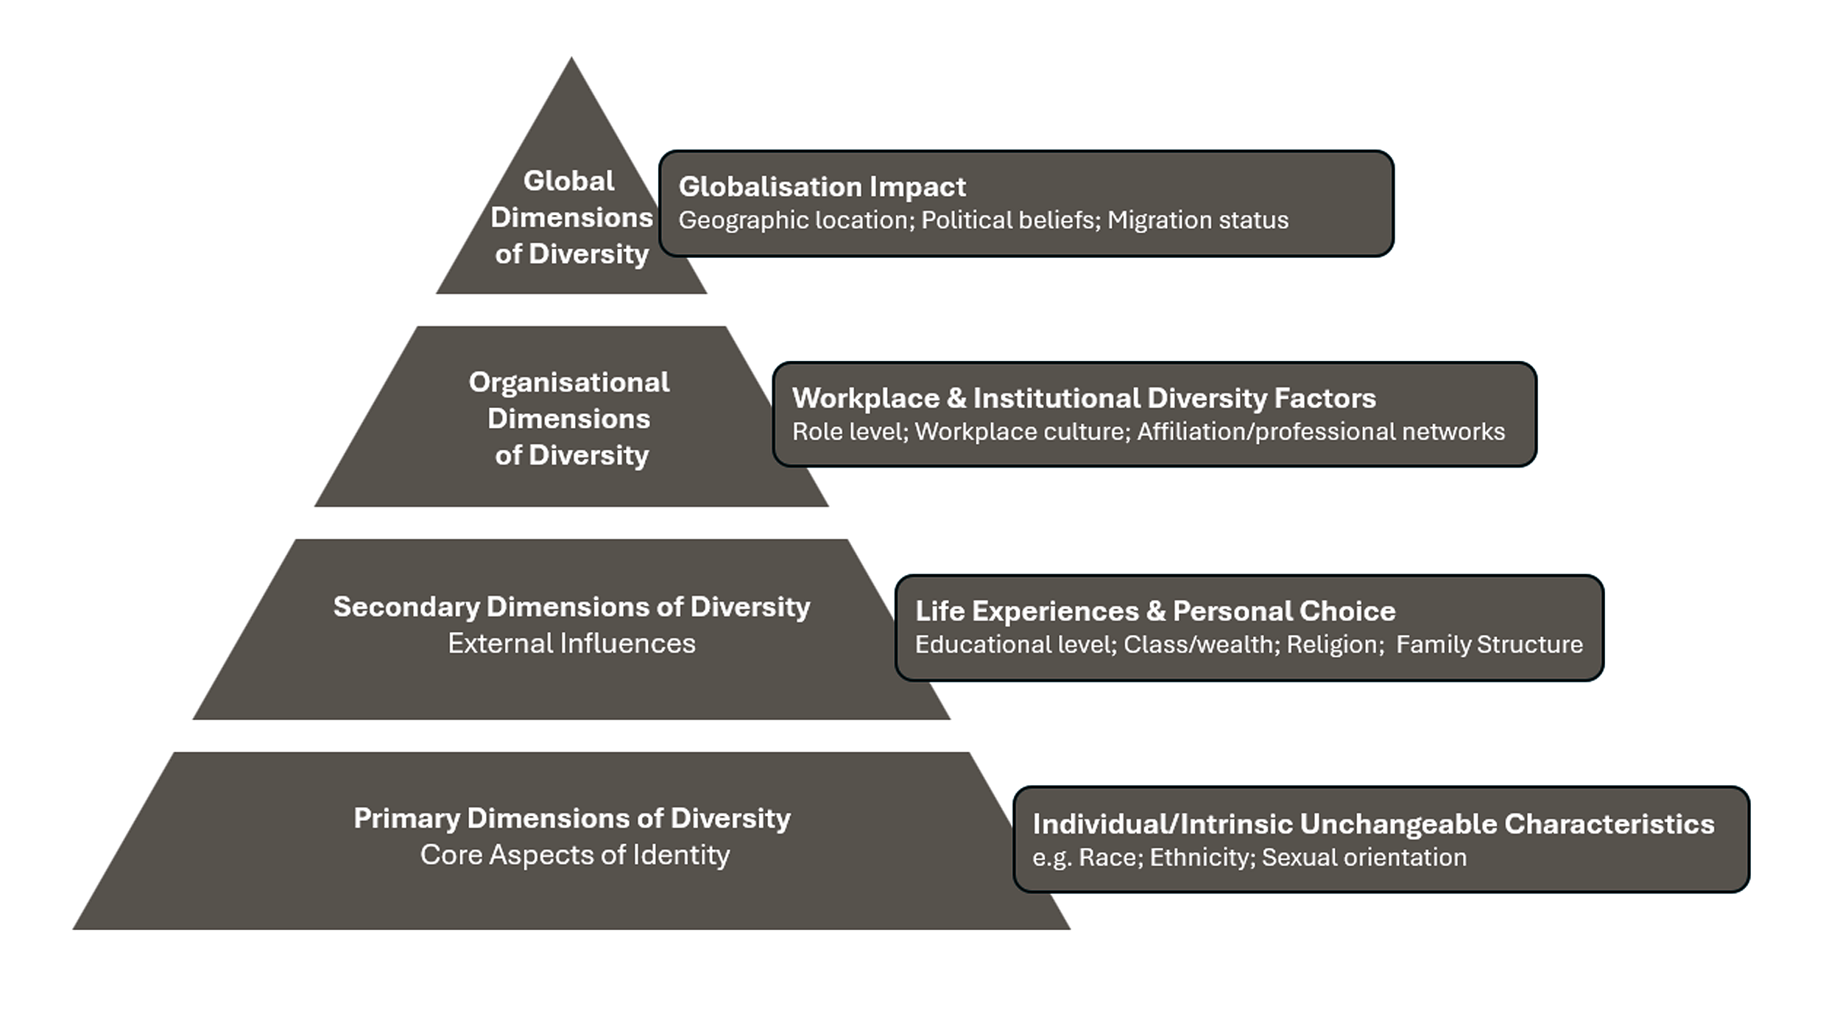
Dimensions of diversity

Slide 10
Cultural Risk and EEDI
Solution-oriented approach to identifying, a managing and mitigating cultural risk in events contexts
Requires development of Emotional Intelligence (EQ), Social Intelligence (SQ) and Cultural Intelligence (CQ)
Embedded as core attributes in events professionals

Slide 11
Cultural Risk – a contemporary events perspective
“The potential for offence, disruption and discomfort that may occur due to an organisation or individual’s ability or inability to identify diversity and intersectional characteristics, and to provide reasonable adjustments for those to environments, spaces or policy or actions which may result in individuals being negatively impacted, socially, emotionally, psychologically otherwise resulting in legal, moral and ethical liability.” (Bernadette Albert, 2023)

Slide 12
Understanding cultural risk as a lens for creating inclusion and representation in events
Diversity recognises that the event space needs to support and cater to difference, and make the most of diverse people’s attributes and characteristics
Enhancing authenticity, not assimilation
Dominant culture of events is white, Eurocentric
Impact of diversity on event planning and management
Beyond tokenism at surface levels
Uncertainty in culture + potential for negative outcomes = Cultural Risk
Ethical and moral obligations - Cultural Risk Assessment becomes a strategic tool for creating more equal outcomes

Slide 13
Diversity, Equity, Equality and Inclusion
Diversity: the presence of individuals from different backgrounds, including but not limited to, race, ethnicity, gender, sexual orientation, age, abilities, from different geographic localities and cultures.
“Equality is giving everyone the same pair of shoes. Equity is giving everyone a pair of shoes that fits.” Enid Lee (n.d.)
Equity acknowledges that not every individual has the same circumstances, and so adjustments are required, through the provision of specific needs to address the disparities faced.
Inclusion is creating environments in which diverse individuals feel represented, valued, can present authentically, developing a sense of belonging, and are facilitated by an ease of navigation.

Slide 14
Complex power dynamics
Power dynamics shape environments and are flexible
Who gets to be in the room
Who gets to speak
Who is heard
Who makes decisions
Avoiding tokenism
Many organisations fall into the trap of ‘virtue signalling’, appearing to do the right thing as part of a Corporate Social Responsibility agenda or to appease clients and stakeholders, rather than address real challenges that underpin discrimination, disenfranchisement, inequality and exclusion.

Slide 15
Bias and overcoming unconscious bias
Unconscious bias, or implicit bias, is a pervasive cognitive phenomenon which influences individuals’ behaviours without conscious awareness.
The keystone for stereotypes, entrenched beliefs, prejudices, and by extension, discrimination and negative perceptions of others who are different to ourselves
System 1 (automatic, instinctive, becomes default setting) and System 2 (problem solving, requires effort) brain thinking
Dominant System 1 brain unconsciously defaults to unconscious bias and stereotypes
See Stereotypes of Discrimination Model

Slide 16
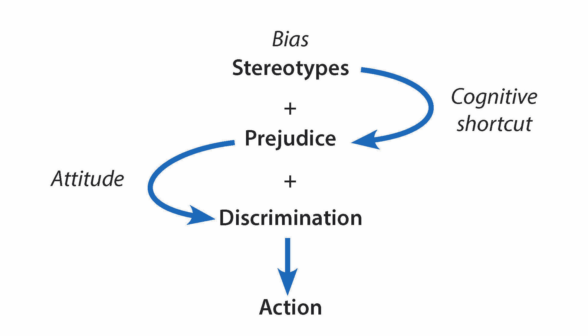

Slide 17
Be AWARE – Bias re-engineering
Acknowledge: that the situation is unfamiliar and that potentially you will gravitate towards automatic thinking; identify when bias or stereotype may be at play
Watch out: for the bias or stereotype, take ownership rather than dismissing it, recognise that cultural and social conditioning is the source of the bias, and therefore influences your thinking.
Ask: distinguish between your assumptions, use critical self-interrogation, ask yourself what the inherited assumptions are, and what are evidence-based assumptions, gain more knowledge to substantiate if necessary.
Reflect: and adapt by shifting the schema, incorporating your new knowledge by consciously reframing your new perspective, consciously updating your pre-existing mental shortcuts.
Engage: Engagement will re-engineer your previous response, thus creating a feedback loop, ensuring that the System 1 thinking is interrupted in the future, and recognise more accurate thinking, minimising the potential for bias in the future.

Slide 18
Summary Chapter 3 (1)
Although benefits of Equity, Equality, Diversity and Inclusion are being challenged globally, this mandate has had a positive impact on the lives of those who are minoritised, discriminated against and marginalised.
Within a superdiverse global environment, the transition from a focus on diversity initiatives to equity and inclusion initiatives become a critical feature in the movement away from performative action, towards meaningful systemic change.
Understanding implicit bias in its relationship with the EEDI agenda is critical.
As individuals, our unconscious bias forms the basis of how we navigate the world also impacting on how we engage with difference.

Slide 19
Summary Chapter 3 (2)
Bias becomes the foundation of cultural risk, where lack of cultural capital and reliance on our existing bias has the potential to create or contribute to cultural risk.
Creating impactful approaches to delivering inclusion requires proactive engagement first through using a bias re-engineering process like AWARE
Building cultural knowledge through the use of tools like the CIERA ultimately fosters higher levels of cultural awareness and addressing bias
A moral and ethical imperative and a necessary strategic commitment for creating fair, equitable and inclusive communities

Slide 20
Discussion questions
How does intersectionality complicate traditional approaches to achieving diversity and inclusion?
What are the key differences between equity and equality?
Why is the distinction between equity and equality critical in EDI initiatives?
How does unconscious bias perpetuate systemic inequities, and what strategies can be used to address it?
How can organizations move beyond tokenism to achieve authentic representation and inclusion?
What opportunities can you take to adopt the AWARE process?

